Slide 1
Checking the wellbeing of our school
Staff presentation

Slide 2
Aims
In this session:
explore the concept of wellbeing and its importance for our students, staff and parents
review the Australian Student Wellbeing Framework
discover some tools for identifying gaps in wellbeing policies, approaches and processes
investigate resources to address areas needing attention
take the School Wellbeing Check survey
Notes:
Welcome! This presentation is all about wellbeing – your students and the whole of our school community. It’s no surprise that wellbeing is rated as one of the essential components of life – directly affecting just about every aspect of our existence from the cradle to the grave.
So, what role do schools play in relation to wellbeing? I’m sure many of you already know the answer to this and will not need convincing of our shared responsibility to build, model and promote a positive, inclusive and respectful school climate where the wellbeing of every person can flourish.
We’re going to take a look at the concept of wellbeing, think about ways we can assess the effectiveness of what we’re already doing, investigate some tools we can use to help us identify areas for improvement and come up with some strategies for bringing about some long-term changes to ensure we’re boosting the wellbeing of everyone in our school community.

Slide 3
Let’s explore
a definition of wellbeing
the components of wellbeing
how wellbeing and learning are linked
what the Australian Student Wellbeing Framework says about wellbeing and safety
tools for assessing wellbeing
the School Wellbeing Check
our strengths and areas needing improvement
studentwellbeinghub.edu.au
Notes:
It’s not going to be all talk – your input is essential. A collaborative effort where there’s staff involvement and ownership of decisions provides the best chance of success! So, jump into the activities. Feel free to ask questions, provide feedback or comments along the way. Let’s get started!

Slide 4
WELLBEING
Your definition?
SDI Productions/Getty Images
Notes:
At your tables/in groups: A 5 minute brainstorm to come up with your definition of ‘WELLBEING’. At the end of 5 minutes we’ll share these (use post-it notes or write these via the whiteboard). Acknowledge the multidimensional nature of the concept, the different interpretations of the concept and the various ways this concept has been used in educational contexts in Australia and elsewhere, across different fields eg psychology, health and wellness, national policy, curriculum etc

Slide 5
Let’s take a look at school wellbeing
The Australian Student Wellbeing Framework
“How do our school policies and approaches align with the Australian Student Wellbeing Framework? ”
Notes:
This short video captures the key elements of the newly-launched Australian Student Wellbeing Framework. After watching, any comments, questions, feedback? What’s your response to the prompt question?

Slide 6
The dimensions of wellbeing
Physical
Psychological
Cognitive
Social
Emotional
Other?
Evidence
?
Notes:
Consider these dimensions of wellbeing on the left. Discuss each and feel free to add others to this list. How do we, or might we, collect evidence about these dimensions in relation to our students? Is understanding how these dimensions apply to ourselves, our parents/families just as important?

Slide 7
Wellbeing and learning
An interdependent relationship
‘There are strong and consistent correlations between wellbeing and academic achievement…’
Bronfenbrenner (1979), Fox (2015)
High levels of student wellbeing lead to better learning outcomes
Successful learning outcomes increase students’ levels of wellbeing
Notes:
Think about the quote and the two statements that follow. What are the implications for our teaching and learning approaches.? Our wellbeing policies? Other?
As educators, we know how important wellbeing is for learning. Evidence shows that when students develop their social and emotional skills for wellbeing, health and safety, there is a direct impact on their learning outcomes.
Are there any opportunities for us to highlight this reciprocal relationship between wellbeing and learning?

Slide 8
Can wellbeing be measured?
How could we measure our students’
Social and emotional skills
Resilience and coping skills
Purpose and meaningfulness in life
Self-direction and engagement
Relationships, connection, sense of belonging
Confidence
Jasmin Merdan/Getty Images
Notes:
If we agree that there’s a direct link between wellbeing and learning outcomes – and we DO measure student learning outcomes/success/achievement etc using a variety of instruments – should we then also be measuring their levels of wellbeing? Should we as a staff be also assessing our own wellbeing levels? DISCUSS and share ways we already measure, assess, observe and communicate these wellbeing dimensions about our students.

Slide 9
Wellbeing surveys and reports
The Student Wellbeing Hub provides a range of evidence and insights about the wellbeing of school-aged young people
Aracy Report Card 2018
Australian Principal Occupational Health, Safety and Wellbeing Survey 2018
Australian Institute of Family Studies Longitudinal Study 2017
Australian Institute of Health and Welfare Report 2018
Mission Australia Youth Survey 2018
Office of eSafety Commissioner Youth Participation Survey 2017
Telethon Kids Institute Young Minds Matter Survey 2017
studentwellbeinghub.edu.au
Notes:
You can access a range of reports and other information gathered about student wellbeing, health and safety on the Student Wellbeing Hub. You might like to follow up on this as part of professional learning.

Slide 10
National responses for improving student wellbeing
Australian Student Wellbeing Framework
National School Improvement Tool
Beyond Blue Be You
National Principles for Child Safe Organisations
More can be found on the Student Wellbeing Hub
studentwellbeinghub.edu.au
Notes:
These are some national policies and frameworks that relate to student wellbeing – again, worth following up after this session.

Slide 11
Let’s explore the School Wellbeing Check tool
Log on to: studentwellbeinghub.edu.au/educators/framework/school-wellbeing-check/
Select Take the Survey (you may need to register to begin)
Individually or with a partner, answer the 25 survey questions
Submit the survey
Notes:
These 25 questions are based on the Australian Student Wellbeing Framework and will give you a snapshot of how you think we’re doing as a school in terms of wellbeing. Once you’ve answered all 25, generate your Report and be ready to share what you’ve discovered. The aim of this exercise is to see what we’re doing well and to identify areas for improvement.
NB If your teachers don’t have access to the Hub site/internet to take the survey please follow the steps below. Then Skip to Slide 13 :
Print off the PDF of the sample 25 question survey and hand out
Staff complete the survey questions
Share their surveys with a partner or group
Although no digital Report will be generated, discussion could take place around questions that ranked lowest or highest on the scale.
Show Slides 13-15 as a ‘mock Report’ – for discussion

Slide 12
Survey results
What did you discover?
View your Report
Any surprises?
Greatest strength?
Area for improvement?
Next steps?
You might like to share your report with colleagues
studentwellbeinghub.edu.au

Slide 13
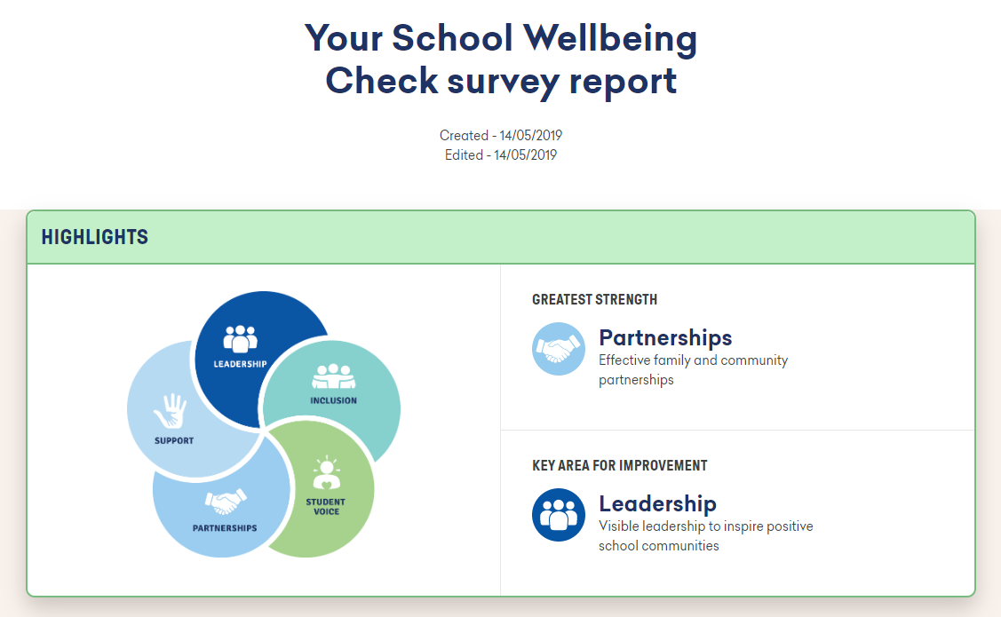
If this was your School Wellbeing Check report….
studentwellbeinghub.edu.au
Notes:
How would you feel about our “greatest strength?” How might we respond to the identified “Key area for improvement”? What practical actions could we take to improve Partnerships?

Slide 14
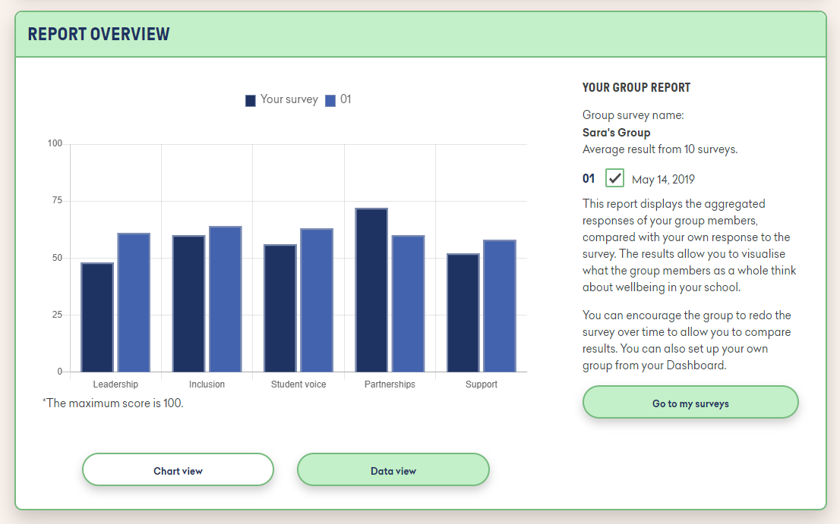
If this was your report…..
studentwellbeinghub.edu.au
Notes:
How would you interpret this graph in terms of a school’s wellbeing?

Slide 15
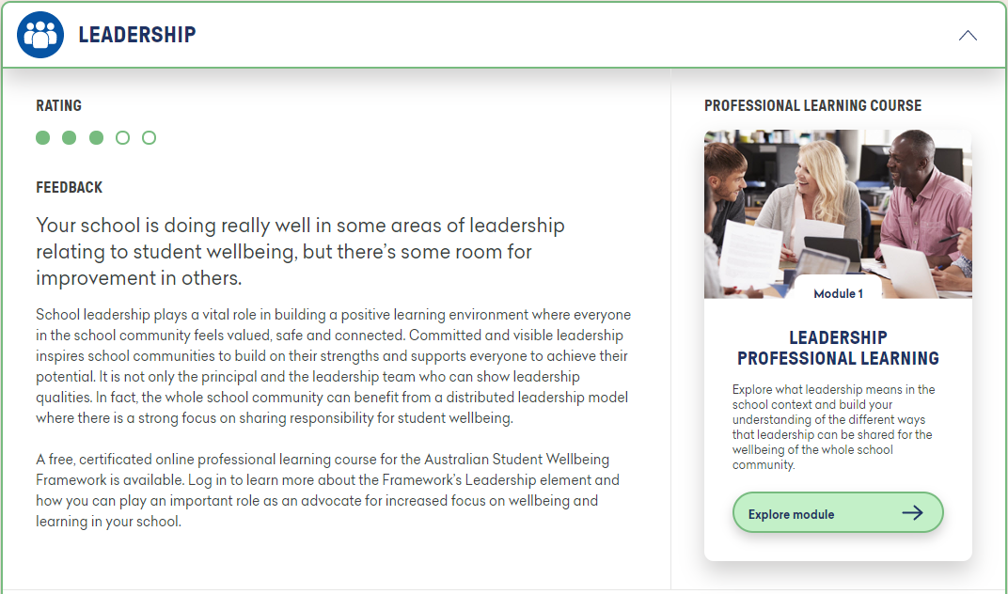
If this was your report…..
studentwellbeinghub.edu.au
Notes:
How useful is this part of the Report?

Slide 16
Key wellbeing priorities for our school
List of our top 3
We will….
We will….
We will….
Thomas Barwick/Getty Images
studentwellbeinghub.edu.au

Slide 17
Group Surveys….
studentwellbeinghub.edu.au
Notes:
If you are using the tool online, you can see that you are able to create a group with colleagues or faculty members to get further insight into your school’s wellbeing.

Slide 18
Notes:
Our key wellbeing priorities will form an integral component of our school improvement plan. More discussion, scoping, maybe consultation etc and certainly actions will follow!
For references, further information and related resources visit the Student Wellbeing Hub.

